Slide 1
Chapter 1
Boolean Logic

Slide 2
Chapter 1: Boolean logic
Boolean logic
Boolean function synthesis
Hardware description language
Hardware simulation
Multi-bit buses
Project 1 overview

Slide 3


Boolean Values
F T
N Y
0 1

Slide 4
Boolean Operations

Slide 5

Boolean Operations
x And y
$$x ∧ y$$
x | y | And
0 | 0 | 0
0 | 1 | 0
1 | 0 | 0
1 | 1 | 1
And

Slide 6

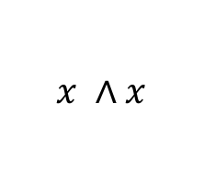
Boolean Operations
x And y x Or y
$$x ∧x$$
$$x∨y$$
x | y | And
0 | 0 | 0
0 | 1 | 0
1 | 0 | 0
1 | 1 | 1
x | y | Or
0 | 0 | 0
0 | 1 | 1
1 | 0 | 1
1 | 1 | 1
And

Slide 7

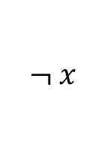
Boolean Operations
x And y x Or y Not(x)
$$x ∧ y$$
$$x∨y$$
$$¬ x$$
x | y | And
0 | 0 | 0
0 | 1 | 0
1 | 0 | 0
1 | 1 | 1
x | y | Or
0 | 0 | 0
0 | 1 | 1
1 | 0 | 1
1 | 1 | 1
x | Not
0 | 1
1 | 0
And

Slide 8
Boolean Expressions
Not(0 Or (1 And 1)) =
Not(0 Or 1) =
Not(1) =
__________

Slide 9
Boolean Functions
f(x, y, z) = (x And y) Or (Not(x) And z)

Slide 10
Boolean Functions
f(x, y, z) = (x And y) Or (Not(x) And z)
x | y | z | f
0 | 0 | 0
0 | 0 | 1
0 | 1 | 0
0 | 1 | 1
1 | 0 | 0
1 | 0 | 1
1 | 1 | 0
1 | 1 | 1
f

Slide 11
Boolean Functions
f(x, y, z) = (x And y) Or (Not(x) And z)
x | y | z | f
0 | 0 | 0
0 | 0 | 1 | 1
0 | 1 | 0
0 | 1 | 1
1 | 0 | 0
1 | 0 | 1
1 | 1 | 0
1 | 1 | 1
(0 And 0) Or (Not(0) And 1) =
0 Or (1 And 1) =
0 Or 1 = 1
f

Slide 12
Boolean Functions
f(x, y, z) = (x And y) Or (Not(x) And z)
x | y | z | f
0 | 0 | 0 | 0
0 | 0 | 1 | 1
0 | 1 | 0 | 0
0 | 1 | 1 | 1
1 | 0 | 0 | 0
1 | 0 | 1 | 0
1 | 1 | 0 | 1
1 | 1 | 1 | 1
f

Slide 13
Boolean Functions
f(x, y, z) = (x And y) Or (Not(x) And z)
formula
x | y | z | f
0 | 0 | 0 | 0
0 | 0 | 1 | 1
0 | 1 | 0 | 0
0 | 1 | 1 | 1
1 | 0 | 0 | 0
1 | 0 | 1 | 0
1 | 1 | 0 | 1
1 | 1 | 1 | 1
truth table
f

Slide 14
Boolean Identities
(x And y) = (y And x)
(x Or y) = (y Or x)
(x And (y And z)) = ((x And y) And z)
(x Or (y Or z)) = ((x Or y) Or z)
(x And (y Or z)) = (x And y) Or (x And z)
(x Or (y And z)) = (x Or y) And (x Or z)
Not(x And y) = Not(x) Or Not(y)
Not(x Or y) = Not(x) And Not(y)
commutative laws (교환법칙)
associative
laws (결합법칙)
distributive
laws (분배법칙)
De Morgan laws

Slide 15
Boolean Algebra
Not(Not(x) And Not(x Or y)) =

Slide 16
Boolean Algebra
De Morgan law
Not(Not(x) And Not(x Or y)) =
Not(Not(x) And (Not(x) And Not(y))) =

Slide 17
Boolean Algebra
Not(Not(x) And Not(x Or y)) =
Not(Not(x) And (Not(x) And Not(y))) =
Not((Not(x) And Not(x)) And Not(y)) =
associative law

Slide 18
Boolean Algebra
Not(Not(x) And Not(x Or y)) =
Not(Not(x) And (Not(x) And Not(y))) =
Not((Not(x) And Not(x)) And Not(y)) =
Not(Not(x) And Not(y)) =
idempotence
(멱등법칙)

Slide 19
Boolean Algebra
Not(Not(x) And Not(x Or y)) =
Not(Not(x) And (Not(x) And Not(y))) =
Not((Not(x) And Not(x)) And Not(y)) =
Not(Not(x) And Not(y)) =
Not(Not(x)) Or Not(Not(y)) =
De Morgan law

Slide 20
Boolean Algebra
Not(Not(x) And Not(x Or y)) =
Not(Not(x) And (Not(x) And Not(y))) =
Not((Not(x) And Not(x)) And Not(y)) =
Not(Not(x) And Not(y)) =
Not(Not(x)) Or Not(Not(y)) =
x Or y
double negation

Slide 21
Boolean Algebra
Not(Not(x) And Not(x Or y)) =

Slide 22
Boolean Algebra
Not(Not(x) And Not(x Or y)) =
x | y | Or
0 | 0 | 0
0 | 1 | 1
1 | 0 | 1
1 | 1 | 1

Slide 23
Boolean Algebra
Not(Not(x) And Not(x Or y)) =
________
x | y | Or
0 | 0 | 0
0 | 1 | 1
1 | 0 | 1
1 | 1 | 1

Slide 24

Chapter 1: Boolean logic
Boolean logic
Boolean function synthesis
Hardware description language
Hardware simulation
Multi-bit buses
Project 1 overview

Slide 25
Boolean expression ➔ truth table
f(x, y, z) = (x And y) Or (Not(x) And z)
x | y | z | f
0 | 0 | 0 | 0
0 | 0 | 1 | 1
0 | 1 | 0 | 0
0 | 1 | 1 | 1
1 | 0 | 0 | 0
1 | 0 | 1 | 0
1 | 1 | 0 | 1
1 | 1 | 1 | 1

Slide 26
Boolean expression ⬅ truth table
f(x, y, z) = (x And y) Or (Not(x) And z)
?
x | y | z | f
0 | 0 | 0 | 0
0 | 0 | 1 | 1
0 | 1 | 0 | 0
0 | 1 | 1 | 1
1 | 0 | 0 | 0
1 | 0 | 1 | 0
1 | 1 | 0 | 1
1 | 1 | 1 | 1

Slide 27
From truth table to a Boolean expression
x | y | z | f
0 | 0 | 0 | 1
0 | 0 | 1 | 0
0 | 1 | 0 | 1
0 | 1 | 1 | 0
1 | 0 | 0 | 1
1 | 0 | 1 | 0
1 | 1 | 0 | 0
1 | 1 | 1 | 0

Slide 28
From truth table to a Boolean expression
x | y | z | f
0 | 0 | 0 | 1 1
0 | 0 | 1 | 0 0
0 | 1 | 0 | 1 0
0 | 1 | 1 | 0 0
1 | 0 | 0 | 1 0
1 | 0 | 1 | 0 0
1 | 1 | 0 | 0 0
1 | 1 | 1 | 0 0
(Not(x) And Not(y) And Not(z))

Slide 29
From truth table to a Boolean expression
x | y | z | f
0 | 0 | 0 | 1 0
0 | 0 | 1 | 0 0
0 | 1 | 0 | 1 1
0 | 1 | 1 | 0 0
1 | 0 | 0 | 1 0
1 | 0 | 1 | 0 0
1 | 1 | 0 | 0 0
1 | 1 | 1 | 0 0
(Not(x) And y And Not(z))

Slide 30
From truth table to a Boolean expression
x | y | z | f
0 | 0 | 0 | 1 0
0 | 0 | 1 | 0 0
0 | 1 | 0 | 1 1
0 | 1 | 1 | 0 0
1 | 0 | 0 | 1 1
1 | 0 | 1 | 0 0
1 | 1 | 0 | 0 0
1 | 1 | 1 | 0 0
(x And Not(y) And Not(z))

Slide 31
From truth table to a Boolean expression
x | y | z | f
0 | 0 | 0 | 1 1
0 | 0 | 1 | 0
0 | 1 | 0 | 1 1
0 | 1 | 1 | 0
1 | 0 | 0 | 1 1
1 | 0 | 1 | 0
1 | 1 | 0 | 0
1 | 1 | 1 | 0
(Not(x) And Not(y) And Not(z))
(Not(x) And y And Not(z))
(x And Not(y) And Not(z))

Slide 32
From truth table to a Boolean expression
x | y | z | f
0 | 0 | 0 | 1
0 | 0 | 1 | 0
0 | 1 | 0 | 1
0 | 1 | 1 | 0
1 | 0 | 0 | 1
1 | 0 | 1 | 0
1 | 1 | 0 | 0
1 | 1 | 1 | 0
(Not(x) And Not(y) And Not(z))
Or
(Not(x) And y And Not(z))
Or
(x And Not(y) And Not(z))
(Not(x) And Not(y) And Not(z)) Or (Not(x) And y And Not(z)) Or (x And Not(y) And Not(z)) =

Slide 33
From truth table to a Boolean expression
x | y | z | f
0 | 0 | 0 | 1
0 | 0 | 1 | 0
0 | 1 | 0 | 1
0 | 1 | 1 | 0
1 | 0 | 0 | 1
1 | 0 | 1 | 0
1 | 1 | 0 | 0
1 | 1 | 1 | 0
(Not(x) And Not(y) And Not(z))
Or
(Not(x) And y And Not(z))
Or
(x And Not(y) And Not(z))
(Not(x) And Not(y) And Not(z)) Or (Not(x) And y And Not(z)) Or (x And Not(y) And Not(z)) =
(Not(x) And Not(z)) Or (x And Not(y) And Not(z)) =
(Not(x) And Not(z)) Or (Not(y) And Not(z)) =
Not(z) And (Not(x) Or Not(y))

Slide 34
Theorem
Lemma: Any Boolean function can be represented using an expression containing And, Or And Not operations.
Proof:
Use the truth table to Boolean expression method
Lemma: Any Boolean function can be represented using an expression containing And and Not operations.
Proof:
(x Or y) = Not(Not(x) And Not(y))
Can we do better than this?

Slide 35
____________
(x _______ y) = Not(x And y)
x | y | Nand
0 | 0 | 1
0 | 1 | 1
1 | 0 | 1
1 | 1 | 0

Slide 36
Theorem (revisited)
Lemma: Any Boolean function can be represented using an expression containing And, Or And Not operations.
Proof:
Use the truth table to Boolean expression method
Lemma: Any Boolean function can be represented using an expression containing And and Not operations.
Proof:
(x Or y) = ___________________
Theorem: Any Boolean function can be represented using an expression containing Nand operations only.
Proof:
Not(x) = (x ________ x)
(x And y) = ______________

Slide 37
Chapter 1: Boolean logic
Boolean logic
Boolean function synthesis
Hardware description language
Hardware simulation
Multi-bit buses
Project 1 overview

Slide 38
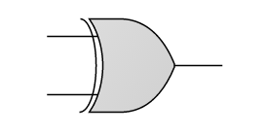
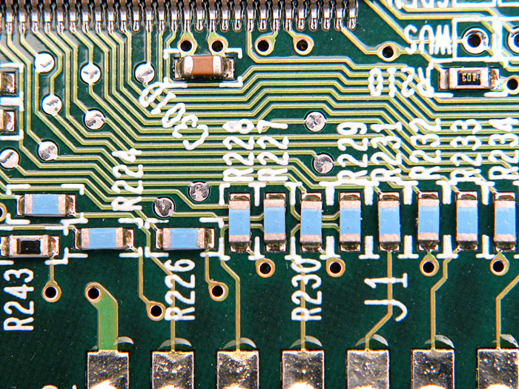
Building a logic gate
a
?
Xor
out
b
outputs 1 if one, and only one, of its inputs, is 1.
The Process:
Design the gate architecture
Specify the architecture in HDL
Test the chip in a hardware simulator
Optimize the design
Realize the optimized design in silicon.

Slide 39
Building a logic gate
a
?
Xor
out
b
outputs 1 if one, and only one, of its inputs, is 1.
The Process:
Design the gate architecture
Specify the architecture in HDL
Test the chip in a hardware simulator
Optimize the design
Realize the optimized design in silicon.

Slide 40
Design: from requirements to interface
a
a | b | out
0 | 0 | 0
0 | 1 | 1
1 | 0 | 1
1 | 1 | 0
Requirement:
Build a gate that delivers this functionality
Xor
out
b
outputs 1 if one, and only one, of its inputs, is 1.
/** Xor gate: out = (a And Not(b)) Or (Not(a) And b)) */
CHIP Xor {
IN a, b;
OUT out;
PARTS:
// Implementation missing
}
Gate interface
Expressed as an HDL stub file

Slide 41
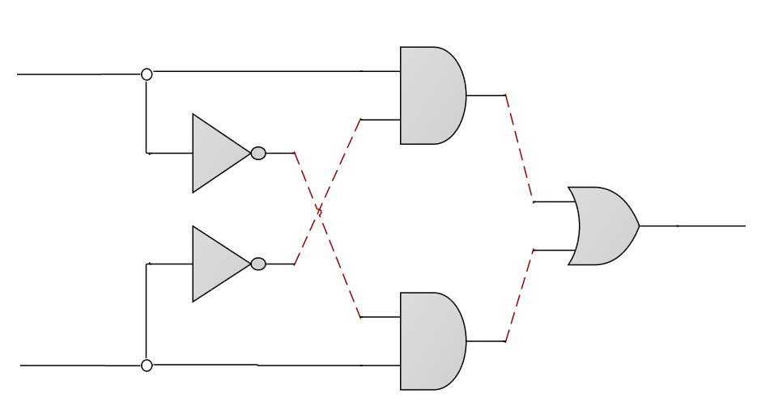

Design: from requirements to gate diagram
a
a | b | out
0 | 0 | 0
0 | 1 | 1
1 | 0 | 1
1 | 1 | 0
Requirement:
Build a gate that delivers this functionality
Xor
out
b
outputs 1 if one, and only one, of its inputs, is 1.
a
And
General idea:
out=1 when:
a And Not(b)
Or
b And Not(a)
Not
Or
out
Not
b
And

Slide 42
Design: from gate diagram to HDL
a
a
And
out
b
in
Not
out
aAndNotb
notb
a
Or
out
out
b
in
Not
nota
out
notaAndb
a
And
out
b
b
/** Xor gate: out = (a And Not(b)) Or (Not(a) And b)) */
CHIP Xor {
IN a, b;
OUT out;
PARTS:
// implementation missing
}

Slide 43
Design: from gate diagram to HDL
a
a
And
out
b
in
Not
out
aAndNotb
notb
a
Or
out
out
b
in
Not
nota
out
notaAndb
a
And
out
b
b
/** Xor gate: out = (a And Not(b)) Or (Not(a) And b)) */
CHIP Xor {
IN a, b;
OUT out;
PARTS:
Not (in=a, out=nota);
Not (_______________________);
And (a=a, b=notb, out=aAndNotb);
And (a=nota, b=b, out=notaAndb);
Or (______________________________________);
}
interface
Other Xor implementations are possible!
implementation

Slide 44
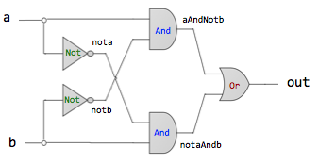
HDL: some comments
/** Xor gate: out = (a And Not(b)) Or (Not(a) And b)) */
CHIP Xor {
IN a, b;
OUT out;
PARTS:
Not (in=a, out=nota);
Not (in=b, out=notb);
And (a=a, b=notb, out=aAndNotb);
And (a=nota, b=b, out=notaAndb);
Or (a=aAndNotb, b=notaAndb, out=out);
}
HDL is a functional / declarative language
The order of HDL statements is insignificant
Before using a chip part, you must know its interface. For example:
Not(in= ,out=), And(a= ,b= ,out= ), Or(a= ,b= ,out= )
Connection patterns like chipName(a=a,…) and chipName(…,out=out) are common

Slide 45

Hardware description languages
Common HDLs:
VHDL
Verilog
Many more HDLs…
Our HDL
Similar in spirit to other HDLs
Minimal and simple
Provides all you need for this course
HDL Documentation:
Textbook / Appendix A
Lecture material / HDL Survival Guide

Slide 46
Chapter 1: Boolean logic
Boolean logic
Boolean function synthesis
Hardware description language
Hardware simulation
Multi-bit buses
Project 1 overview

Slide 47
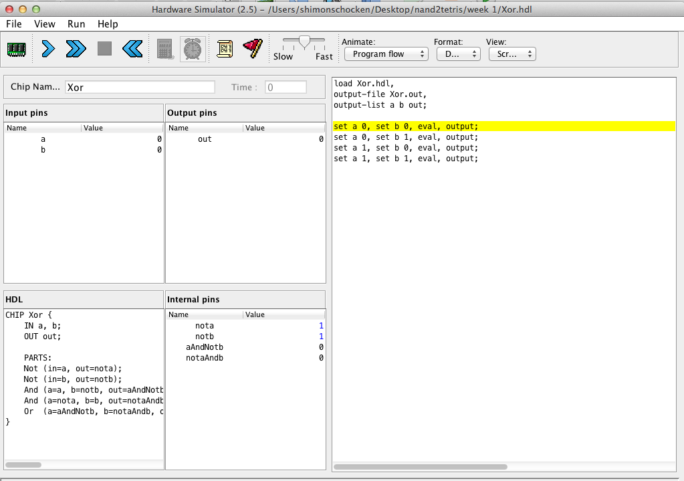
Hardware simulation in a nutshell
CHIP Xor {
IN a, b;
OUT out;
PARTS:
Not (in=a, out=nota);
Not (in=b, out=notb);
And (a=a, b=notb, out=aAndNotb);
And (a=nota, b=b, out=notaAndb);
Or (a=aAndNotb, b=notaAndb, out=out);
}
HDL code
simulate
load Xor.hdl,
output-file And.out,
output-list a b out;
set a 0, set b 0, eval, output;
set a 0, set b 1, eval, output;
set a 1, set b 0, eval, output;
set a 1, set b 1, eval, output;
test script
hardware simulator
Simulation options:
Interactive
Script-based
With / without output and compare files

Slide 48
Interactive simulation (using Xor as an example)
Xor.hdl
CHIP Xor {
IN a, b;
OUT out;
PARTS:
Not (in=a, out=nota);
Not (in=b, out=notb);
And (a=a, b=notb, out=aAndNotb);
And (a=nota, b=b, out=notaAndb);
Or (a=aAndNotb, b=notaAndb, out=out);
}
a
And
Not
notb
aAndNotb
Or
out
Not
nota
notaAndb
b
And
Simulation process:
Load the HDL file into the hardware simulator
Enter values (0’s and 1’s) into the chip’s input pins (e.g. a and b)
Evaluate the chip’s logic
Inspect the resulting values of:
Output pins (e.g. out)
Internal pins (e.g. nota, notb, aAndNotb, notaAndb)

Slide 49
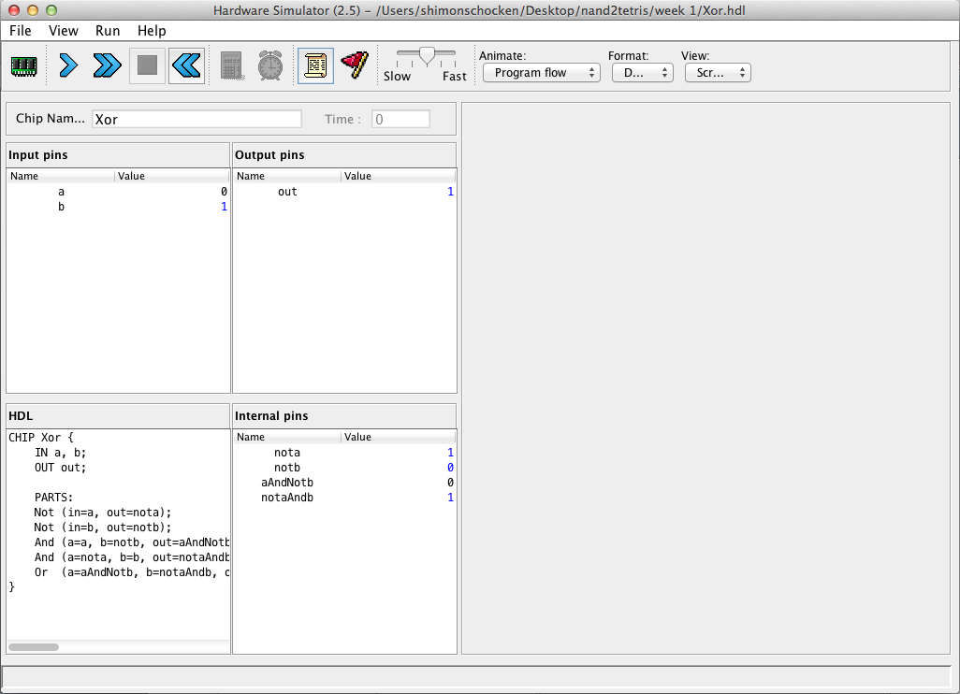

Interactive simulation
2. evaluate the chip logic
3. inspect output pins
1. manipulate
input pins
4. inspect internal pins
HDL code

Slide 50
Script-based simulation
Xor.hdl
Xor.tst
CHIP Xor {
IN a, b;
OUT out;
PARTS:
Not (in=a, out=nota);
Not (in=b, out=notb);
And (a=a, b=notb, out=aAndNotb);
And (a=nota, b=b, out=notaAndb);
Or (a=aAndNotb, b=notaAndb, out=out);
}
load Xor.hdl;
set a 0, set b 0, eval;
set a 0, set b 1, eval;
set a 1, set b 0, eval;
set a 1, set b 1, eval;
tested chip
test script = series of commands to the simulator
Benefits:
“Automatic” testing
Replicable testing

Slide 51
Script-based simulation, with an output file
Xor.hdl
Xor.tst
CHIP Xor {
IN a, b;
OUT out;
PARTS:
Not (in=a, out=nota);
Not (in=b, out=notb);
And (a=a, b=notb, out=aAndNotb);
And (a=nota, b=b, out=notaAndb);
Or (a=aAndNotb, b=notaAndb, out=out);
}
load Xor.hdl,
output-file Xor.out,
output-list a b out;
set a 0, set b 0, eval, output;
set a 0, set b 1, eval, output;
set a 1, set b 0, eval, output;
set a 1, set b 1, eval, output;
tested chip
test
script
tested chip
Xor.out
The logic of a typical test script
Initialize:
Load an HDL file
Create an empty output file
List the names of the pins whose values will be written to the output file
Repeat:
set – eval - output
| a | b |out|
| 0 | 0 | 0 |
| 0 | 1 | 1 |
| 1 | 0 | 1 |
| 1 | 1 | 0 |
Output File, created by the test script as a side-effect of the simulation process

Slide 52
Script-based simulation
inspect the output file
run the script
test script
HDL code

Slide 53
Hardware simulators
There are many of them!
Our hardware simulator
Minimal and simple
Provides all you need for this course
Hardware simulator documentation:
Hardware Simulator Tutorial

Slide 54
Revisiting script-based simulation with output files
Xor.hdl
Xor.tst
CHIP Xor {
IN a, b;
OUT out;
PARTS:
Not (in=a, out=nota);
Not (in=b, out=notb);
And (a=a, b=notb, out=aAndNotb);
And (a=nota, b=b, out=notaAndb);
Or (a=aAndNotb, b=notaAndb, out=out);
}
load Xor.hdl,
output-file Xor.out,
output-list a b out;
set a 0, set b 0, eval, output;
set a 0, set b 1, eval, output;
set a 1, set b 0, eval, output;
set a 1, set b 1, eval, output;
tested chip
test script
Xor.out
| a | b |out|
| 0 | 0 | 0 |
| 0 | 1 | 1 |
| 1 | 0 | 1 |
| 1 | 1 | 0 |
Output file, created by the test script as a side-effect of the simulation process

Slide 55
Script-based simulation, with compare files
Xor.hdl
Xor.tst
CHIP Xor {
IN a, b;
OUT out;
PARTS:
Not (in=a, out=nota);
Not (in=b, out=notb);
And (a=a, b=notb, out=aAndNotb);
And (a=nota, b=b, out=notaAndb);
Or (a=aAndNotb, b=notaAndb, out=out);
}
load Xor.hdl,
output-file Xor.out,
compare-to Xor.cmp,
output-list a b out;
set a 0, set b 0, eval, output;
set a 0, set b 1, eval, output;
set a 1, set b 0, eval, output;
set a 1, set b 1, eval, output;
tested chip
test script
Xor.cmp
Xor.out
| a | b |out|
| 0 | 0 | 0 |
| 0 | 1 | 1 |
| 1 | 0 | 1 |
| 1 | 1 | 0 |
Simulation-with-compare-file logic
When each output command is executed, the outputted line is compared to the corresponding line in the compare file
If the two lines are not the same, the simulator throws a comparison error.
| a | b |out|
| 0 | 0 | 0 |
| 0 | 1 | 1 |
| 1 | 0 | 1 |
| 1 | 1 | 0 |

Slide 56
Behavioral simulation
Xor.hdl
Xor.tst
CHIP Xor {
IN a, b;
OUT out;
BUILTIN Xor
// Built-in chip implementation,
// can execute in the hardware
// simulator like any other chip.
}
load Xor.hdl,
output-file Xor.out,
output-list a b out;
set a 0, set b 0, eval, output;
set a 0, set b 1, eval, output;
set a 1, set b 0, eval, output;
set a 1, set b 1, eval, output;
built-in chip implementation
test script
Behavioral simulation:
The chip logic (abstraction) can be implemented in some high-level language
Enables high-level planning and testing of a hardware architecture before writing any HDL code.
Xor.out
Xor.cmp
| a | b |out|
| 0 | 0 | 0 |
| 0 | 1 | 1 |
| 1 | 0 | 1 |
| 1 | 1 | 0 |
| a | b |out|
| 0 | 0 | 0 |
| 0 | 1 | 1 |
| 1 | 0 | 1 |
| 1 | 1 | 0 |

Slide 57
Hardware construction projects
The players (first approximation):
System architects
Developers
The system architect decides which chips are needed
For each chip, the architect creates
A chip API
A test script
A compare file
Given these resources, the developers can build the chips.

Slide 58
The developer’s view (of, say, a Xor gate)
Xor.hdl
Xor.tst
/** returns 1 if (a != b) */
CHIP Xor {
IN a, b;
OUT out;
PARTS:
// Implementation missing
}
load Xor.hdl,
output-file Xor.out,
compare-to Xor.cmp
output-list a b out;
set a 0, set b 0, eval, output;
set a 0, set b 1, eval, output;
set a 1, set b 0, eval, output;
set a 1, set b 1, eval, output;
stub file
test script
Taken together, the three files provide a convenient specification of:
The chip interface (.hdl)
What the chip is supposed to do (.cmp)
How to test the chip (.tst)
The developer’s task: implement the chip, using these resources.
Xor.cmp
compare file
| a | b |out|
| 0 | 0 | 0 |
| 0 | 1 | 1 |
| 1 | 0 | 1 |
| 1 | 1 | 0 |

Slide 59
Chapter 1: Boolean logic
Boolean logic
Boolean function synthesis
Hardware description language
Hardware simulation
Multi-bit buses
Project 1 overview

Slide 60
Arrays of Bits
Sometimes we wish to manipulate an array of bits as one group
It’s convenient to think about such a group of bits as a single entity, sometime termed “bus”
HDLs usually provide notation and means for handling buses.

Slide 61
Example: adding 16-bit integers
/*
* Adds two 16-bit inputs.
*/
CHIP Add16 {
IN __________, _________;
OUT _____________;
PARTS:
...
}
/*
* Adds three 16-bit inputs.
*/
CHIP Add3Way16 {

Slide 62
Example: adding 16-bit integers
/*
* Adds two 16-bit values.
*/
CHIP Add16 {
IN a[16], b[16];
OUT out[16];
PARTS:
...
}
/*
* Adds three 16-bit inputs.
*/
CHIP Add3Way16 {
IN first[16], second[16], third[16];
OUT out[16];
PARTS:
Add16(a=first, b=second, out=temp);
Add16(a=temp, b=third, out=out);
}

Slide 63
Working with individual bits within buses
/*
* 4-way And: Ands 4 bits.
*/
CHIP And4Way {

Slide 64
Working with individual bits within buses
/*
* 4-way And: Ands 4 bits.
*/
CHIP And4Way {
IN a[4];
OUT out;
PARTS:
And(a=a[0], b=a[1], out=_________);
And(a=________, b=a[2], out=t012);
And(a=t012, b=a[3], out=out);
}

Slide 65
Working with individual bits within buses
/*
* Bit-wise And of two 4-bit inputs
*/
CHIP And4 {

Slide 66
Working with individual bits within buses
/*
* Bit-wise And of two 4-bit inputs
*/
CHIP And4 {
IN a[4], b[4];
OUT out[4];
PARTS:
And(a=a[0], b=b[0], out=_________);
And(a=a[1], b=b[1], out=out[1]);
And(a=a[2], b=b[2], out=out[2]);
And(a=a[3], b=b[3], out=out[3]);
}

Slide 67
Sub-buses
Buses can be composed from (and decomposed into) sub-buses
...
IN lsb[8], msb[8], …
...

Slide 68
Sub-buses
Buses can be composed from (and decomposed into) sub-buses
Some syntactic choices of our HDL
buses are indexed right to left: if foo is a 16-bit bus, then foo[0] is the right-most bit, and foo[15] is the left-most bit
overlaps of sub-buses are allowed in output buses of parts
width of internal pin buses is deduced automatically
The false and true constants may be used as buses of any width.
내부핀f 에 대해서
x=f[0..3] 이런 표현은 안됨.
입력핀i에 대해서는
w=i[0..3] 은 됨.
최종 out 핀에 대해서
y=out[0..3] 이런 표현도 안됨
...
IN lsb[8], msb[8], …
...
Add16(a[0..7]=lsb, a[8..15]=msb, b=…, out=…);
Add16(…, out[0..3]=t1, out[4..15]=t2);

Slide 69
Chapter 1: Boolean logic
Boolean logic
Boolean function synthesis
Hardware description language
Hardware simulation
Multi-bit buses
Project 1 overview

Slide 70


Nand to Tetris course methodology
here’s a logic gate, go build computer
how?
one step at a time
Project 1: the first step

Slide 71
Project 1
Given: Nand
Goal: Build the following gates:
Elementary logic gates
16-bit variants
Multi-way variants
Not
And
Or
Xor
Mux
DMux
Not16
And16
Or16
Mux16
Or8Way
Mux4Way16
Mux8Way16
DMux4Way
DMux8Way
Why these 15 particular gates?
Commonly used gates
Comprise all the elementary logic gates needed to build our computer.

Slide 72
Project 1
Given: Nand
Goal: Build the following gates:
Elementary logic gates
16-bit variants
Multi-way variants
Not
And
Or
Xor
Mux
DMux
Not16
And16
Or16
Mux16
Or8Way
Mux4Way16
Mux8Way16
DMux4Way
DMux8Way

Slide 73
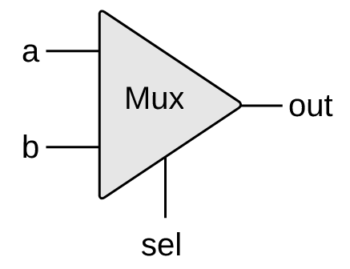
Multiplexor
a | b | sel | out
0 | 0 | 0 | 0
0 | 1 | 0 | 0
1 | 0 | 0 | 1
1 | 1 | 0 | 1
0 | 0 | 1 | 0
0 | 1 | 1 | 1
1 | 0 | 1 | 0
1 | 1 | 1 | 1
sel | out
0 | a
1 | b
abbreviated truth table
if (sel==0)
out=a
else
out=b
A 2-way multiplexor enables selecting, and outputting, one of two possible inputs
Widely used in:
Digital design
Communications networks

Slide 74
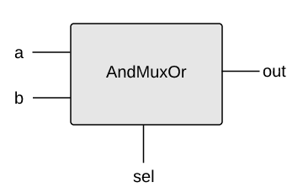
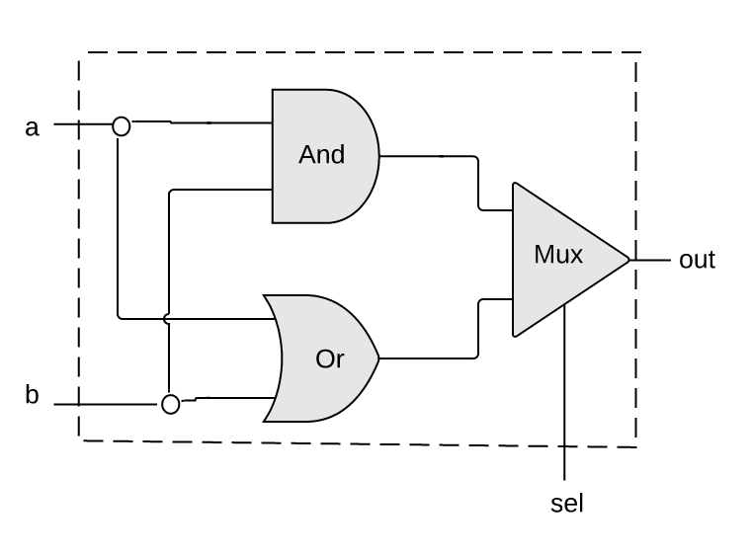
Example: using mux logic to build a programmable gate
a | b | sel | out
0 | 0 | 0 | 0
0 | 1 | 0 | 0
1 | 0 | 0 | 0
1 | 1 | 0 | 1
0 | 0 | 1 | 0
0 | 1 | 1 | 1
1 | 0 | 1 | 1
1 | 1 | 1 | 1
When sel==0 the gate acts like an And gate
When sel==1 the gate acts like an Or gate
if (sel==0)
out = (a And b)
else
out = (a Or b)
Mux.hdl
CHIP AndMuxOr {
IN a, b, sel;
OUT out;

Slide 75
Example: using mux logic to build a programmable gate
a | b | sel | out
0 | 0 | 0 | 0
0 | 1 | 0 | 0
1 | 0 | 0 | 0
1 | 1 | 0 | 1
0 | 0 | 1 | 0
0 | 1 | 1 | 1
1 | 0 | 1 | 1
1 | 1 | 1 | 1
When sel==0 the gate acts like an And gate
When sel==1 the gate acts like an Or gate
if (sel==0)
out = (a And b)
else
out = (a Or b)
Mux.hdl
CHIP AndMuxOr {
IN a, b, sel;
OUT out;
PARTS:
And (a=a, b=b, out=andOut);
Or (a=a, b=b, out=orOut);
Mux (a=andOut, b=orOut, sel=sel, out=out);
}

Slide 76
Multiplexor implementation
if (sel==0)
out=a
else
out=b
sel | out
0 | a
1 | b
Mux.hdl
CHIP Mux {
IN a, b, sel;
OUT out;
PARTS:
// Put your code here:
}
Implementation tip:
Can be implemented with And, Or, and Not gates

Slide 77
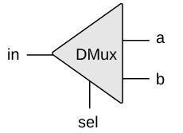
Demultiplexor
in | sel | a | b
0 | 0 | 0 | 0
0 | 1 | 0 | 0
1 | 0 | 1 | 0
1 | 1 | 0 | 1
if (sel==0)
{a,b}={in,0}
else
{a,b}={0,in}
DMux.hdl
Acts like the “inverse” of a multiplexor
Distributes the single input value into one of two possible destinations
CHIP DMux {
IN in, sel;
OUT a, b;
PARTS:
// Put your code here:
}

Slide 78
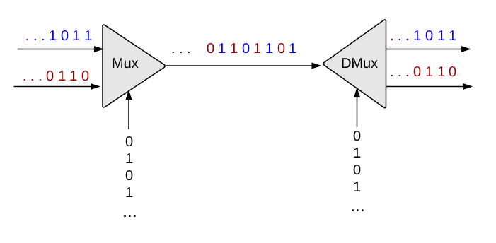
Example: Multiplexing / demultiplexing in communications networks
source
destination
Each sel bit is connected to an oscillator that produces a repetitive train of alternating 0 and 1 signals
Enables transmitting multiple messages on a single, shared communications line
A common use of multiplexing / demultiplexing logic
Unrelated to this course.

Slide 79
Project 1
Elementary logic gates
16-bit variants
Multi-way variants
Not
And
Or
Xor
Mux
DMux
Not16
And16
Or16
Mux16
Or8Way
Mux4Way16
Mux8Way16
DMux4Way
DMux8Way

Slide 80
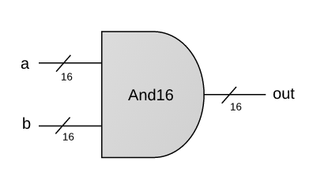
And16
CHIP And16 {
IN a[16], b[16];
OUT out[16];
PARTS:
// Put your code here:
}
a = 1 0 1 0 1 0 1 1 0 1 0 1 1 1 0 0
b = 0 0 1 0 1 1 0 1 0 0 1 0 1 0 1 0
out = 0 0 1 0 1 0 0 1 0 0 0 0 1 0 0 0
A straightforward 16-bit extension of the elementary And gate
(See previous slides on working with multi-bit buses)

Slide 81
Project 1
Elementary logic gates
16-bit variants
Multi-way variants
Not
And
Or
Xor
Mux
DMux
Not16
And16
Or16
Mux16
Or8Way
Mux4Way16
Mux8Way16
DMux4Way
DMux8Way

Slide 82
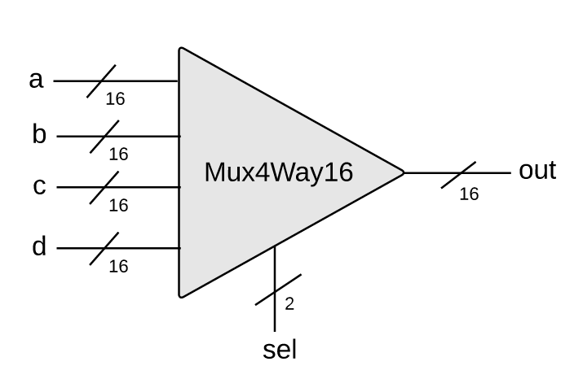
16-bit, 4-way multiplexor
sel[1] | sel[0] | out
0 | 0 | a
0 | 1 | b
1 | 0 | c
1 | 1 | d
Mux4Way16.hdl
CHIP Mux4Way16 {
IN a[16], b[16], c[16], d[16],
sel[2];
OUT out[16];
PARTS:
// Put your code here:
}
Implementation tip:
Can be built from several Mux16 gates

Slide 83

Project 1
Given: Nand
Goal: Build the following gates:
Elementary logic gates
16-bit variants
Multi-way variants
Not
And
Or
Xor
Mux
DMux
Not16
And16
Or16
Mux16
Or8Way
Mux4Way16
Mux8Way16
DMux4Way
DMux8Way
So how to actually build these gates?

Slide 84
Chip building materials (using Xor as an example)
Xor.cmp
The contract:
a
a b out
0 0 0
0 1 1
1 0 1
1 1 0
When running your Xor.hdl on the supplied Xor.tst, your Xor.out should be the same as the supplied Xor.cmp
Xor
out
b
outputs 1 if a != b
Xor.hdl
Xor.tst
CHIP Xor {
IN a, b;
OUT out;
PARTS:
// Put your code here.
}
load Xor.hdl,
output-file Xor.out,
compare-to Xor.cmp,
output-list a b out;
set a 0, set b 0, eval, output;
set a 0, set b 1, eval, output;
set a 1, set b 0, eval, output;
set a 1, set b 1, eval, output;

Slide 85
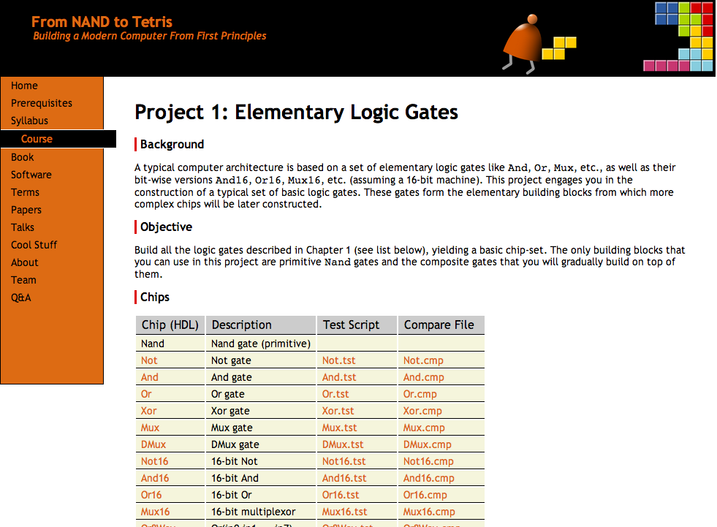
Project 1 Resources
www.nand2tetris.org
All the necessary project 1 files are available in:
nand2tetris/projects/01

Slide 86
More resources
Text editor (for writing your HDL files)
HDL Survival Guide
Hardware Simulator Tutorial
nand2tetris Q&A forum
All available in: www.nand2tetris.org

Slide 87
Hack chipset API
a
a
And
out
b
in
Not
out
a
Or
out
out
b
in
Not
out
a
And
out
b
b
CHIP Xor {
IN a, b;
OUT out;
PARTS:
Not (in= , out=);
Not (in= , out=);
And (a= , b= , out=);
And (a= , b=b , out=);
Or (a= , b= , out=);
}
When deciding to use some chip-parts, how do I know the names of their input and output pins?

Slide 88
Hack chipset API
Add16 (a= ,b= ,out= );
ALU (x= ,y= ,zx= ,nx= ,zy= ,ny= ,f= ,no= ,out= ,zr= ,ng= );
And16 (a= ,b= ,out= );
And (a= ,b= ,out= );
Aregister (in= ,load= ,out= );
Bit (in= ,load= ,out= );
CPU (inM= ,instruction= ,reset= ,outM= ,writeM= ,addressM= ,pc= );
DFF (in= ,out= );
DMux4Way (in= ,sel= ,a= ,b= ,c= ,d= );
DMux8Way (in= ,sel= ,a= ,b= ,c= ,d= ,e= ,f= ,g= ,h= );
Dmux (in= ,sel= ,a= ,b= );
Dregister (in= ,load= ,out= );
FullAdder (a= ,b= ,c= ,sum= ,carry= );
HalfAdder (a= ,b= ,sum= , carry= );
Inc16 (in= ,out= );
Keyboard (out= );
Memory (in= ,load= ,address= ,out= );
Mux16 (a= ,b= ,sel= ,out= );
Mux4Way16 (a= ,b= ,c= ,d= ,sel= ,out= );
Mux8Way16 (a= ,b= ,c= ,d= ,e= ,f= ,g= ,h= ,sel= ,out= );
Mux8Way (a= ,b= ,c= ,d= ,e= ,f= ,g= ,h= ,sel= ,out= );
Mux (a= ,b= ,sel= ,out= );
Nand (a= ,b= ,out= );
Not16 (in= ,out= );
Not (in= ,out= );
Or16 (a= ,b= ,out= );
Or8Way (in= ,out= );
Or (a= ,b= ,out= );
PC (in= ,load= ,inc= ,reset= ,out= );
PCLoadLogic (cinstr= ,j1= ,j2= ,j3= ,load= ,inc= );
RAM16K (in= ,load= ,address= ,out= );
RAM4K (in= ,load= ,address= ,out= );
RAM512 (in= ,load= ,address= ,out= );
RAM64 (in= ,load= ,address= ,out= );
RAM8 (in= ,load= ,address= ,out= );
Register (in= ,load= ,out= );
ROM32K (address= ,out= );
Screen (in= ,load= ,address= ,out= );
Xor (a= ,b= ,out= );
(see HDL Survival Guide @ www.nand2tetris.org)

Slide 89
Built-in chips
CHIP Foo {
IN ...;
OUT ...;
PARTS:
...
Mux16(...)
...
}
Q: What happens if there is no Mux16.hdl file in the current directory?

Slide 90
Built-in chips
CHIP Foo {
IN ...;
OUT ...;
PARTS:
...
Mux16(...)
...
}
Q: What happens if there is no Mux16.hdl file in the current directory?
A: The simulator invokes, and evaluates, the built-in version of Mux16 (if such exists).
The supplied simulator software features built-in chip implementations of all the chips in the Hack chip set
If you don’t implement some chips from the Hack chipset, you can still use them as chip-parts of other chips:
Just rename their given stub files to, say, Mux16.hdl1
This will cause the simulator to use the built-in chip implementation.

Slide 91
Best practice advice
Try to implement the chips in the given order
If you don’t implement some chips, you can still use them as chip-parts in other chips (the built-in implementations will kick in)
You can invent new, “helper chips”; however, this is not required: you can build any chip using previously-built chips only
Strive to use as few chip-parts as possible.

Slide 92
Chapter 1: Boolean logic
Boolean logic
Boolean function synthesis
Hardware description language
Hardware simulation
Multi-bit buses
Project 1 overview

